Slide 1
The AFRL Minority Leaders – Research Collaboration Program
ASHELEY BLACKFORD, MINORITY LEADERS – RESEARCH COLLABORATION PROGRAM MATERIALS AND MANUFACTURING DIRECTORATE

Slide 2
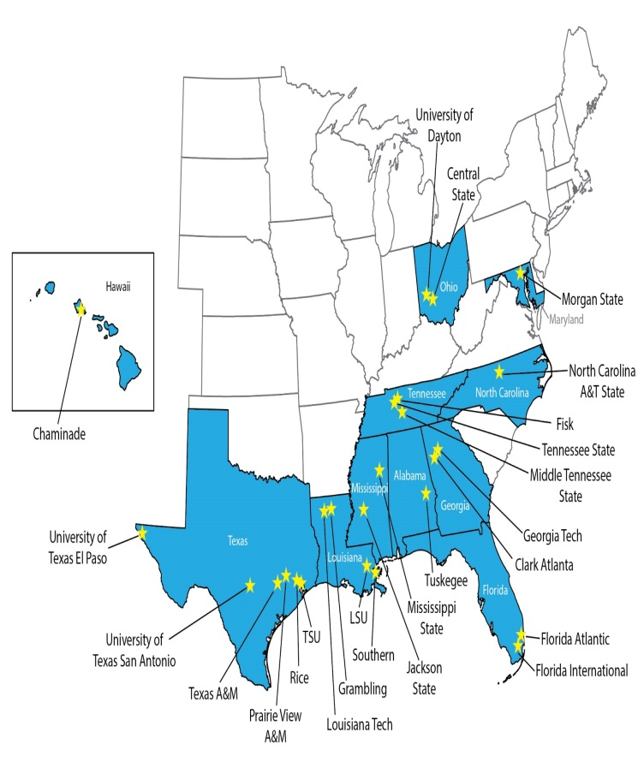
AFRL Minority Leaders – Research Collaboration Program
AFRL Minority Leaders Program (MLP) initiated in 2005
Evolved into the AFRL Minority Leaders – Research Collaboration Program (ML-RCP) in 2013 – 2021 (16 year effort in total)
ML-RCP remains largest HBCU/MSI research initiative in USAF
Single largest endeavor with HBCUs/MSIs funded by the Air Force
36 university participants (HBCUs, MSIs, and IHEs)
Employs a mentor/protégé format through the research collaborations
Over 700 students and 200 professors participate to date
Energizes students across the U.S. to pursue to STEM degrees
79 research efforts across RX-36, RY-34, RI-5, RQ-3, RH-1
GaTech/TAMU Materials Science and Engineering/Data Analytics Program
Developing interdisciplinary materials scientist with data expertise
Students and faculty have access to unique lab facilities and world class experts
Highly structured summer Research activities
171 Internships from 2013-2021

Slide 3
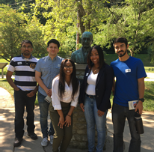
What is the ML-RCP/ Program Objectives
Enable and enhance the Historically Black Colleges and Universities (HBCUs) and Minority Serving Institutions (MSIs) R&D collaborative efforts with AFRL
Develop the research capabilities at the HBCU/MSIs by enabling the collaboration with mentor universities and AFRL research experts
Energize minority students’ (US citizens) pursuit of studies in the areas of science and engineering
Access to a diverse pool of S&E graduate candidates for the nation
Create opportunities for interactions with AFRL scientists and engineers

Slide 4
Students and Alumni (2005-2020)
Total Student Participants | Doctorate | Masters | Bachelors | Graduate | No Data Available
778 | 167 | 148 | 380 | 37 | 46
Total Doctorate Participants | HBCU/MIs in ML/RCP | Non-minority institution in ML/RCP | University not participating in ML/RCP
167 | 71 | 37 | 59
Doctorate includes: PhD, MD, DO, EdD, & PharmD
Masters includes: MS, MA, & ME
Bachelors includes: BA & BS
Graduate: Attending(ed) graduate school – degree unknown

Slide 5
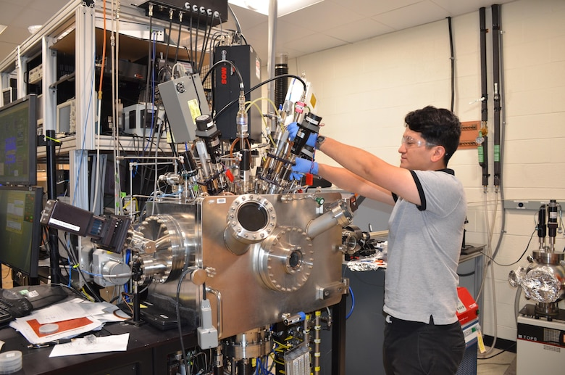
Summer Student Program
171 internships (2013 – 2020)
Up to 12 weeks at AFRL
Faculty visit opportunities based on project need
Access to a national lab
Hands on experience working in AFRL alongside world class subject matter experts
Top of the line research equipment and materials
Inspire students to pursue STEM degrees and careers
Students are given exciting research projects to work on year-around
Empowering students to be innovative and achieving their highest potential
Notes:
Picture from 2018

Slide 6
Benefits/Payoffs
Benefits to Universities:
Enhanced science education including new graduate courses
Increased participation by under represented students in graduate programs
Summer participation at WPAFB energizes and motivates students and faculty
Increase university research network for faculty
Support cutting edge research for students and faculty
Recognition of HBCU/MSI faculty members as excellent researchers
Participation in more scientific conferences by submitting manuscripts and presentations
Enhancement of university’s equipment/software

Slide 7
Benefits/Payoffs (Cont’d)
Benefits to AFRL Directorates/Industry:
New source of quality university research
Highly trained “pool” of excellent S&E graduates
Opportunity to increase diversity of workforce
Access to innovative thoughts from culturally and scientifically diverse sources

Slide 8
Government Employment
Summer Interns: Materials & Manufacturing, Sensors, Information, Airman Systems, & Aerospace Systems Directorates
Full-time Employment:
AFRL HQ
Materials and Manufacturing Directorate
Sensors Directorate
National Air & Space Intelligence Center
Other Intelligence Agencies
NAVAIR
Naval Surface Warfare Center
Lakehurst Naval Air Station
US Army
Missile Defense Agency
DOE National Laboratories
US State Department

Slide 9
Corporate Employment
American Electric Power
Analytical Laboratories
Bayer
Boeing
British Petroleum
Cleveland Clinic
Creative Virtual Ltd
Digidesign
Dow Chemical
Expressions Unlim.
Exxon-Mobile
Harris Corp.
IBM
Keil Company
Lockheed Martin
Microsoft
Northrop Grumman
Pratt & Whitney
Raytheon
Shell Oil
Square D
Stress Eng. Services
Systems Planning Corp.
Wal-Mart Info Sys.

Slide 10
Program Highlights
Single largest endeavor with HBCU/MIs
Over 700 students and 200 university professors have participated in the program to date
Employs a mentor/protégé format that grown from eight to 36 universities
79 research efforts performed across (RX, RY, RI, RQ, and RH) AFRL Directorates structured to advance research objectives addressing the technical needs of our nation’s Air Force
Highly Structured Summer Student Research Program
University/Research Mentor agreement
Energizes students across the United States (US) to pursue science and engineering degrees
Provides hands on experience/guidance and access to unique laboratory facilities and world class experts

Slide 11
Questions?
Asheley Blackford
Program Manager
Minority Leaders Research Collaboration Program
AFRL/RXOP
asheley.blackford@us.af.mil
(937) 255-7107

Slide 12
Back-Up

Slide 13
Previous ML-RCP University Participants List
Grown from 8 to 36 University Participants!
Boise State University
Central State University
City College of New York
Chaminade University
Clark Atlanta University
Fisk University
Florida Atlantic University
Florida International University
Georgia Institute of Technology
Grambling State University
Jackson State University
Morgan State University
Norfolk State University
North Carolina University
Prairie View University
Rice University
Louisiana State University
Louisiana Tech University
Middle Tennessee University
Mississippi State University
Southern University
Tennessee State University
Texas A&M University
Texas Southern University
Texas Tech University
Tuskegee University
University of Colorado
University of Dayton
University of Houston
University of Illinois at Urbana Champaign
University of New Mexico
University of North Texas
University of Texas at El Paso
University of Texas at San Antonio
Wright State University
Wilberforce University

