Slide 1
Army Research and Student Opportunities
Mr. Michael Caccuitto
Branch Chief, Technology Integration & Outreach
DEVCOM ARL- Army Research Office
michael.j.caccuitto.civ@mail.mil
919-549-4369
Distribution A: Approved for Public Release
08 MAR 2021

Slide 2
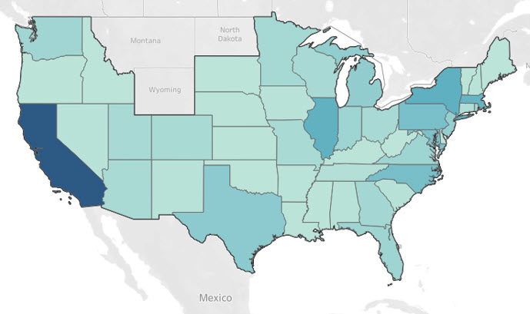
Aro mISSION
01
02
03
04
05
Build the Future
Solve Existing Problems
Accelerate
Educate
Prepare
Create and direct scientific discoveries for revolutionary new Army capabilities
Drive science to develop solutions to existing Army technology needs
Accelerate transition of basic research
Educate and train future Army S&E workforce
Prevent technological surprises
ARO Research Activities
ARO Strategy
256+ Institutes of Higher Learning
(CONUS and OCONUS)
1121 Individual Investigators
46 States and 15 Countries
Scientific Discovery
Diversity & Inclusion throughout the Portfolio
SI, MURI, UARCs, Conferences, SBIR, STTR
Build Capacity
People
Programs – STEM, DURIP, PECASE, YIP, Vannevar Bush, HBCU/MI, ECA…
Leverage Stakeholder Involvement
ARMY – USASOC, MRMC, USACE
ONR, AFOSR, DARPA, DTRA
Asynchronous Adaptation
Continue looking for the Best
3-5 year cycle of reassessing
FY17-FY19 Program
$13,624 $77,383,460

Slide 3
ARL-ARO HBCU/MI ProgramS & Activity
Partnered Research Initiative (PRI)
(FY20)
To enhance the programs and capabilities of a select number of high-interest scientific and engineering disciplines through innovative collaborative research with ARL CRA/CTA Consortia.
Funding: $1.24M
Impact: 1 HBCU, 5 MIs
DEVCOM Core HBCU/MI Program (FY20)
To engage and incentivize greater participation of
HBCUs/MIs in Army basic research.
Funding: $26.7M
Impact: 3 HBCUs, 27 MIs
Grant and Cooperative Agreement Awards in FY20
Collaborative Technology/Research Alliances (CTA/CRAs), High Performance Computing Research, and University Affiliated Research Centers (UARCs) Subawards
To encourage greater HBCU/MI participation on university & industry-led research teams in areas of high Army interest.
Funding: $1.4M RDT&E
Impact: 1 HBCUs, 6 MIs
Design Relationships
Build science and technology ecosystem that will encourage ground-breaking advances in areas of relevance to the Army through research collaboration.
Impact: 2 HBCU, 8 MIs
Mechanisms: 28 JWS, 12 CRADAs (FY19)
Contract Research, Development, Test and Evaluation
Principally to leverage unique capabilities of a minority-serving institution in Electronic Warfare, Cyber and System of Systems supporting ARL at White Sands Missile Range.
Funding: $7.1M RDT&E
Impact: 2 MIs, 1 HBCU
Educational Outreach
Inspire students to pursue STEM thru the following mechanisms:
OSD Centers of Excellence
Student Apprentice Programs
Faculty Fellow Research Teams
University Student Internships
High School and Undergraduate Research Apprenticeships
Educational Partnership Agreements
Impact: 3 HBCUs 1MI COE
16 HBCUs, 40 MIs (EPAs)
Over 5,000 student participants

Slide 4
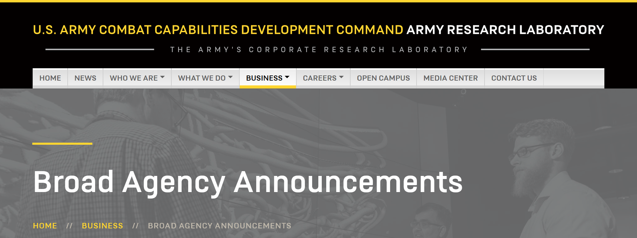
Broad Agency announcements (BAAs)
Broad Agency Announcements
The latest ARL-ARO BAAs can be found at arl.army.mil/business /broad-agency-announcements
Also, the US Army Corps of Engineers Engineer Research and Development Center (ERDC)
erdc.usace.army.mil/Business-With-Us
And, US Army Medical Research And Development Command (MRDC)
usamraa.army.mil/Pages/BAA.aspx
Funding Opportunities
You can find closing dates and application details for all funding opportunities

Slide 5
Funding Vehicles
Award Type | Target | Funding
Single Investigator (SI) | Single-laboratory projects | $140K/year (avg) for 3 years
Short Term Innovative Research (STIR) | Very high-risk pilot projects | $60K for 9 months
Early Career Program Program (ECP) | Early-career PIs | $120K/year for 3 years
Presidential Early Career Award for Scientists and Engineers (PECASE) | Promising future leaders | $200K/year for 5 years
Defense University Research Instrumentation Program (DURIP) | Instrumentation | $200K (avg) per award
Multidisciplinary University Research Initiative (MURI) | Large multidisciplinary programs | ~$1.25M/year up to 5 years
Historically Black College/University and Minority Institution (HBCU/MI) | Minority serving institutions | ~$120K/year for 3 years
Small Business Technology Transfer (STTR) | Multi-phase awards bridging academia & industry | $170K (6 mo.) to $1.1M (12-24 mo.)
Small Business Innovation Research (SBIR) | Multi-phase research for industry transition | $150K (6 mo.) to $1M+ (24 mo.)

Slide 6
Process: proposal evaluation and selection
Development of Ideas
*
*
*
PM interactions with potential PIs
White Papers
Receive Proposals
Science Peer Review
Army Lab/Centers Review
Analysis of Evaluations
PM Recommendation Management Assessment

Slide 7
Process: Grant monitoring and closout
Grant is Awarded
ARO PM Monitors Program with SC/SLs
Discussions via Phone, Email, and at Conferences
Site Visits and Collaborations
Annual Progress Reports, Manuscripts
Grant Ends

Slide 8
upcoming HBCU/mi initiatives
Faculty Immersion Program
Likely ~24 months in duration
Will sponsor PI to conduct research after time spent at collaborating R1 institution and at ARL
Provides funding to institution to cover teaching duties
Topic Areas TBD
Will probably target junior faculty (similar to the ECP)
Faculty Prize Competition
Pitch competition for prize of cooperative agreement to work with ARL researchers
Student Design Pitch Competition
Similar to prior Student Design Competition, will allow students from covered institutions to compete for cash prizes

Slide 9
Army Research and Student Opportunities
1.
Read BAAs. Familiarize yourself with relevant opportunities available.
2.
Be proactive: Get involved. Self-identify interest and reach out to the identified POC to begin dialogue
3.
Don’t be afraid to collaborate. Often partnering, if permitted in a specific opportunity, can strengthen a proposal.
Michael Caccuitto
michael.j.caccuitto.civ@mail.mil
919-549-4369
Questions?

