Slide 1
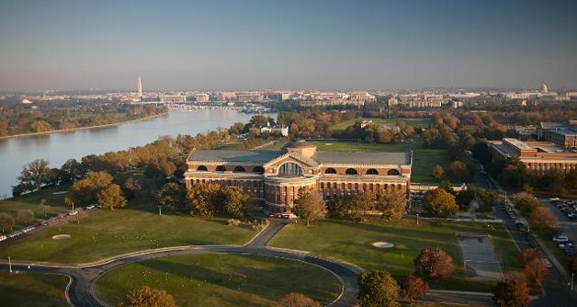
A Conversation about
Education & Opportunities
Rear Admiral Cedric Pringle
31st Commandant
National War College
8 April 2021
Dream Big, Work Hard, and Never Quit!
Notes:
Let's have a conversation about "Faith, Family, and Freedom". I recognize that a lot of people respond differently to the word faith.....some about it strictly in the spiritual sense and others think about faith in institutions like our government. Others think about that ALL ENCOMPASSING faith that lets you sleep comfortably at night, knowing that the sun will rise in the morning.....and if it didn’t we would all have much bigger problems than anything we think is significant today. For the purposes of this conversation, I will speak about my faith, my family, and what drives my pursuit of freedom.
I will also share with you the story of one of America's most courageous heroes and we can discuss the things that he did as a result of his Faith in our great country, for his Family, and for their Freedom.

Slide 2
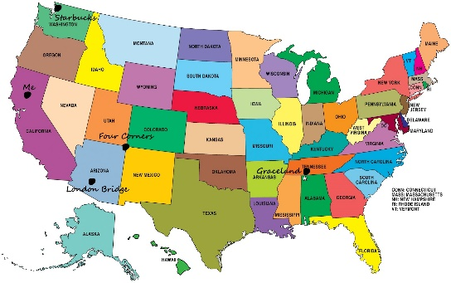
Sumter, SC…..where my journey started!
Population: 24,921 in 1980
Primary Industry: Textile
Primary DoD facility: SHAW AFB
Household median income: $39k
This Photo by Unknown Author is licensed under CC BY-NC-ND
Dream Big, Work Hard, and Never Quit!

Slide 3
Education…..
Youngest of 6 children (first generation to attend college)
Joined Navy for education, opportunities, and experience
University of South Carolina (1986) (STEM-focused)
Naval Postgraduate School (1998) (STEM-focused)
Naval War College (2003) (National Security Strategy focused)
Dream Big, Work Hard, and Never Quit!

Slide 4
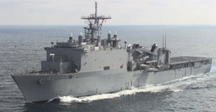
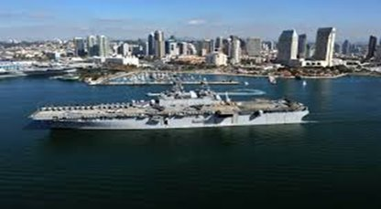
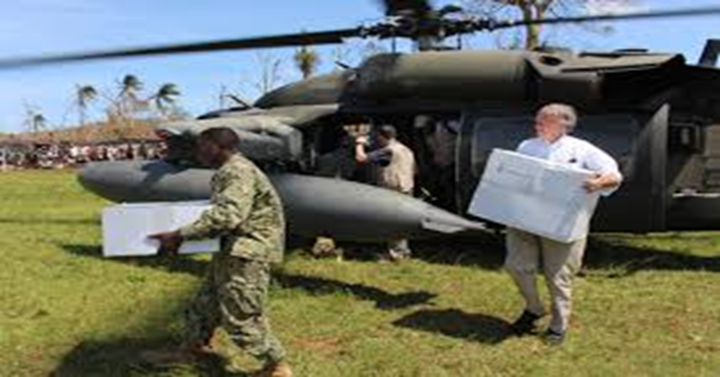
Opportunities…..
CAPITOL HILL
USS WHIDBEY ISLAND (LSD 41)
JTF MATTHEW (HAITI)
USS MAKIN ISLAND (LHD 8)
“Do not judge me by my successes, judge me by how many times I fell down and got back up again.”
Nelson Mandela
Dream Big, Work Hard, and Never Quit!

Slide 5
Opportunities personified....
Commanded Navy's 1st Hybrid Propulsion Drive Ship (2012-2013)
Earned POTUS Volunteer Service Medal for Outreach and Engagement (2013)
1st African American to serve as the Navy's Senate Liaison (2013-2015)
Commanded Navy's Largest Strike Group with 15 ships and 15,000 Sailors & Marines
Conducted Navy’s first Arctic Expeditionary Capabilities Exercise (2019)
Directly supported 6 Humanitarian Assistance & Disaster Relief Missions (2007-2016)
Traveled to 77 different countries (1987-2019)
Commands the Nation’s top National Security Strategy Institution (2019-Present)
Dream Big, Work Hard, and Never Quit!

Slide 6
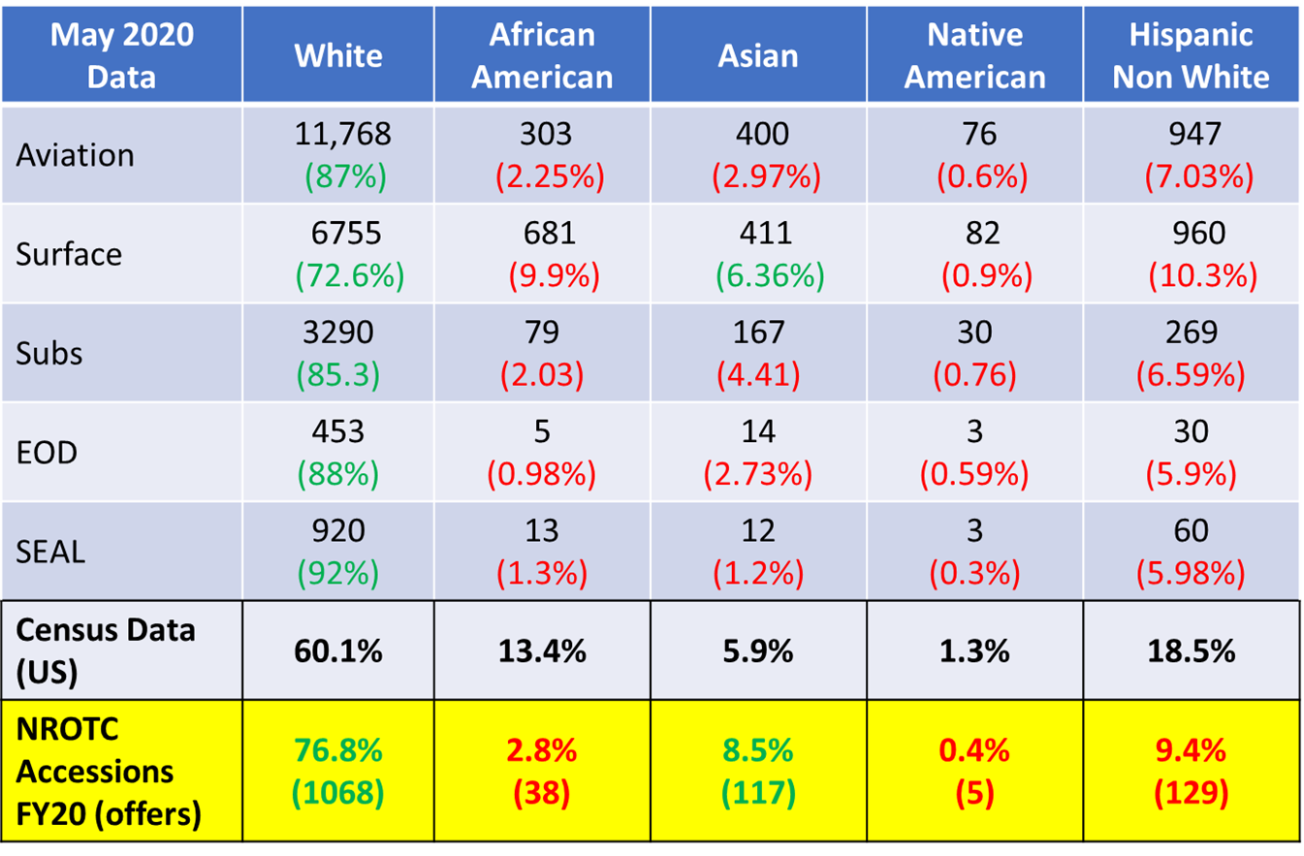
Warfighter Officer Demographics FY20
(17) HBCUs associated w/the NROTC Program
FAMU
Hampton
PVAM (Prairie View)
Texas Southern
Savannah State
Allen
Southern University
Huston-Tillotson
Dillard
Xavier
Tennessee St
Howard
Morehouse College
Clark Atlanta
Spelman
Norfolk State
Tuskegee University
FY | African Americans Application | African American 4-Yr Offers
11 | 313 | 42
12 | 322 | 40
13 | 343 | 48
14 | 259 | 19
15 | 242 | 41
16 | 199 | 20
17 | 139 | 12
18 | 82 | 15
19 | 54 | 16
Dream Big, Work Hard, and Never Quit!

Slide 7
Navy ROTC Scholarship Program Requirements
Minority Serving Institution Scholarship Reservation (MSISR)
BASIC ELIGIBILITY REQUIREMENTS
• Be a U.S. citizen of any race, gender, or ethnic background
• Be 17 years old by Sept. 1 of the first year of college
• Not older than 23 years old by Dec. 31 of the year you start college
• Complete high school/equivalent certificate
• Take the ACT or SAT test
SPECIFIC REQUIREMENTS FOR MSISR
• Must be a Navy Option applicant (Marine Corps and Nurse Corps Option applicants are not eligible)
• Must successfully receive nomination from MSI to be considered for the MSISR scholarship
• Applicants must apply to one of the NROTC affiliated MSIs, if not currently enrolled
• Applicants must be admitted to the MSI in order to use their scholarship if selected
SAT: 540 Math; 550 Reading and Writing (1150 Combined Score)
ACT: 21 Math; 22 English (47 Combined Score)
https://www.netc.navy.mil/Commands/Naval-Service-Training-Command/NROTC/
Requirements/
Dream Big, Work Hard, and Never Quit!

Slide 8
Navy ROTC and Commissioning Programs Contact Information
Rear Admiral Milton J. Sands Office: (847) 688-3400
Commander, Naval Service Training Command milton.sands@navy.mil
Donovan D. Phillips, Ph.D. Office: (847) 688-2500
Executive Director | Deputy Commander Mobile: (224) 545-3578
Naval Service Training Command donovan.phillips@navy.mil
Captain Glen Leverette USN Mobile: (904) 420-8086
Diversity & Inclusion Manger glevere1@ju.edu
Naval Service Training Command
Rear Admiral Dennis Velez USN Office: (901) 874-9499
Commander, Navy Recruiting Command Mobile: (571) 242-6826
dennis.velez2@navy.mil
Commander Howard Bryant
Navy Recruiting Command howard.bryant@navy.mil
Dream Big, Work Hard, and Never Quit!

Slide 9
What’s Next?
Dream Big, Work Hard, and Never Quit!

Slide 10
Our history is built on Faith, Family, and Freedom!

Slide 11
Why?
“Education is the most powerful weapon which you can use to change the world.”
-Nelson Mandela
Dream Big, Work Hard, and Never Quit!

Slide 12
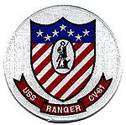
Other tours of interest
This Photo by Unknown Author is licensed under CC BY-SA

