Slide 1
Department of the Navy’s (DoN) Historically Black Colleges Universities and Minority Institutions (HBCU/MI)Program
Anthony C. Smith, Sr.
Director/Program Manager
Presenter: Reginald G. Williams, PhD
ONR Program Officer
Approved for Public Release DCN #: 43-6991-20

Slide 2
ADMINISTERING OFFICES
(SECNAVINST 5402.31A)
Secretary of the Navy
Chief of Naval Research
DON HBCU/MI PROGRAM
DIRECTOR
Advisory Board
U.S. Marine Corps
Recruiting Command
Office of Civilian
Human Resources
Office of Strategic
Systems Programs
Administering Offices
Chief of
Naval
Operations
Office of
Naval
Research
Naval Air
Systems
Command
Naval Sea
Systems
Command
Naval Supply
Systems
Command
Bureau of
Medicine
and Surgery
Headquarters
U.S.
Marine Corps
Naval Information
Warfare Systems
Command
United States
Naval Research
Lab
Office of the
Deputy Chief
Of Naval Operations
Naval Facilities
Engineering
Command
Approved for Public Release DCN #: 43-6991-20

Slide 3
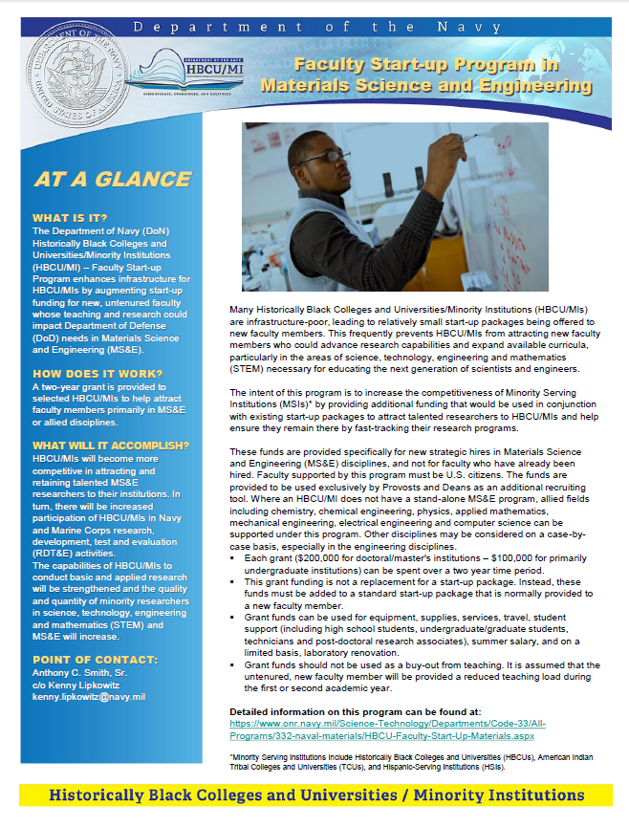
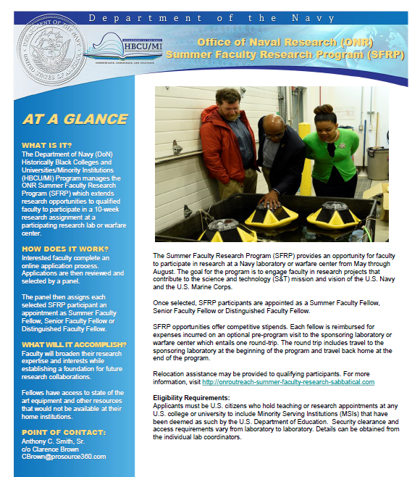
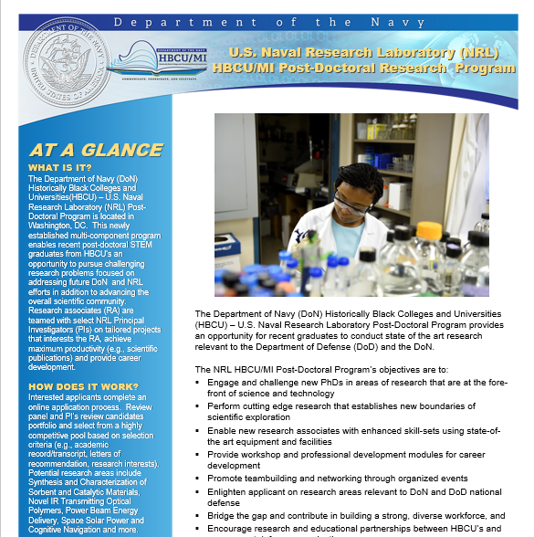
FACULTY FELLOWSHIPS
Approved for Public Release DCN #: 43-6991-20

Slide 4
FACULTY OPPORTUNITIES
Funding Opportunity Announcement
HBCU/MI faculty conduct naval-relevant research on their campuses, integrating undergraduate/graduate students in the process
Evaluation Criteria
Technical Merit and Project Implementation
Naval Relevance
Student Engagement Strategy
Principal Investigator Qualifications
Two-phase Submission Process
White paper
Invited Proposal
Grants will be up to $150,000 per year for up to 3 years
Approved for Public Release DCN #: 43-6991-20

Slide 5
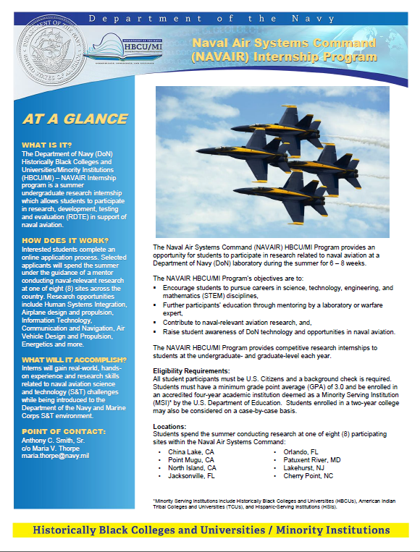
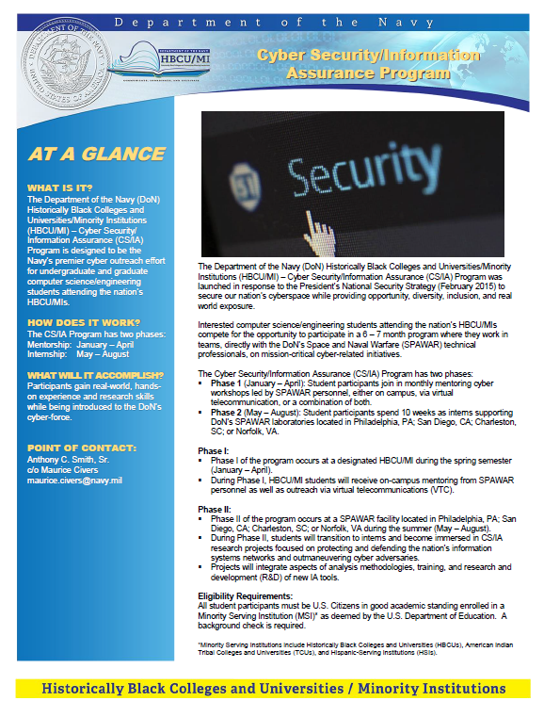
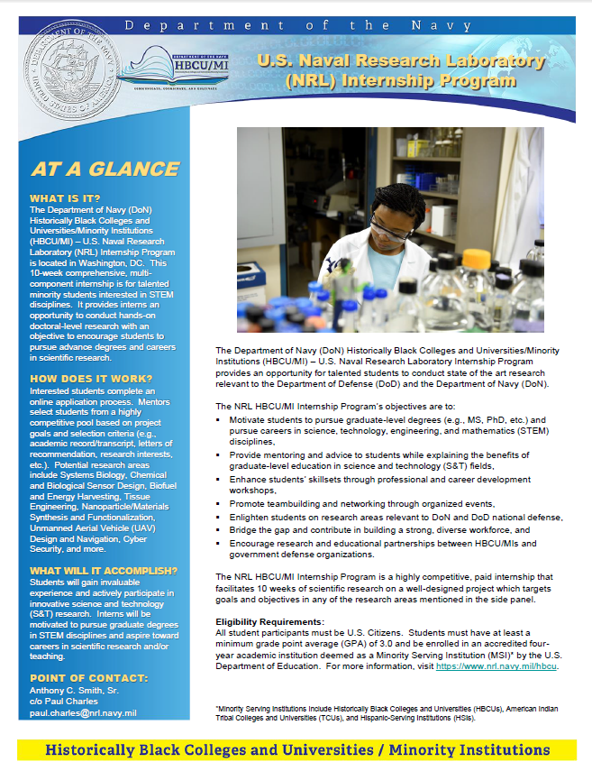
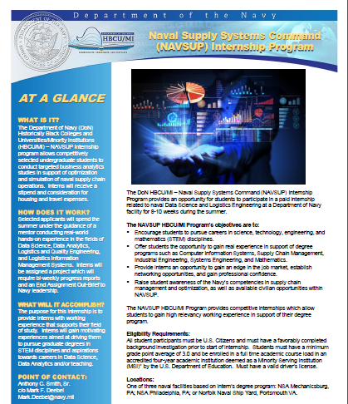
STUDENT INTERNSHIPS
Approved for Public Release DCN #: 43-6991-20

Slide 6
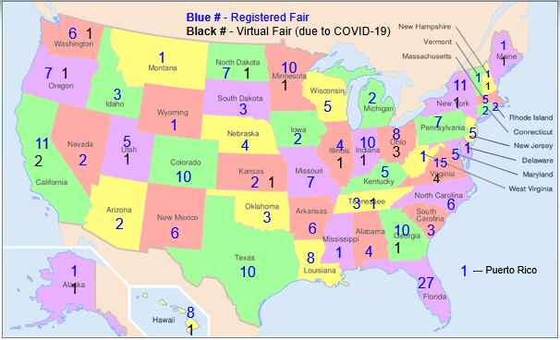
NAVAL SCIENCE AWARDS PROGRAM
Number of Fairs – 257
NSAP Award Packets mailed to Science Fairs – 1,612
Gift Cards for Regional and State Science Fair Winners - 246
$10,000 Scholarship for ISEF Winner - 0
Number of Science Fairs Registered
by State on ONR Website in 2020
Approved for Public Release DCN #: 43-6991-20

Slide 7
Questions
Approved for Public Release DCN #: 43-6991-20

