Slide 1
Introduction to White House Initiative on HBCUs
March 2021
Notes:
Tammi
Hello! My name is Tammi Fergusson and on behalf of the entire initiative team I'd like to welcome you to today’s presentation, Introduction to the White House Initiative on Historically Black Colleges and Universities. This presentation was specifically designed for our new federal agency partners interested in joining the Interagency Working Group or recently designated as the official agency Liaison by their Secretary.
Our hope is that you will walk away from the presentation with a general working knowledge about the history, structure and goals of the Initiative. As well as the important role that our federal agency partners play in carrying out the Executive Order tied to our office.
To begin, lets take a look at today’s agenda…

Slide 2
Agenda
The History of the Initiative
Introduction to the Team
Programming
Interagency Working Group
Student Engagement and Outreach
National HBCU Week Conference
President’s Board of Advisors
What Can We Do For You!
Notes:
Tammi to Present
To begin we will have an:
The History of the Initiative
Introduction to the Team
The Interagency Working Group
Reporting
Clusters
Student Outreach and Engagement
Operations and Partnerships
What Can We Do For You!
To kick things off, I am going to pass the presentation over to Nya Wheeler, one of the Initiatives' Office Automation Clerks, to give you a brief introduction to the team and history lesson. Nya…

Slide 3
The Origin Story
In 1980, President Jimmy Carter signed an executive order to distribute adequate resources and funds to strengthen HBCUs.
His executive order manifested the White House Initiative on Historically Black Colleges and Universities (WHI-HBCU).
The office has been renewed by every administration through Executive Orders.
Notes:
Nya to present.
First, what is a Historically Black College and University?
The Higher Education Act of 1965, as amended, defines an HBCU as: “…any historically black college or university that was established prior to 1964, whose principal mission was, and is, the education of black Americans, and that is accredited by a nationally recognized accrediting agency or association determined by the Secretary [of Education] to be a reliable authority as to the quality of training offered or is, according to such an agency or association, making reasonable progress toward accreditation.”
In 1980, President Jimmy Carter signed an executive order to distribute adequate resources and funds to strengthen HBCUs.
His executive order manifested the White House Initiative on Historically Black Colleges and Universities (WHI-HBCU).
The office has been renewed by every administration since through Executive Orders.

Slide 4
The Initiative
Empowered by Presidential Executive Order 13779
The “constitution” of the Initiative
Led by an Executive Director
Appointed by the President
Housed in the Executive Office of the President
Domestic Policy Council
Operations in the Department of Education
Team of career employees; works across the entire federal government
Striving to increase the capacity of HBCUs to provide the highest-quality education to an increasing number of students.
Notes:
Nya to present.
Currently, the office operates under Executive order 13779. The executive order serves as the constitution of the initiative. The initiative is led by an executive director that is appointed by the president to serve during the administrations term. The executive director sits on the domestic policy council in the executive office of the president. The daily operations of the initiative are conducted by a small team of career employees housed in the US Department of Education.
Let’s take a deeper look at the current Initiative team.

Slide 5
The Initiative Career Staff Team
Arthur P. McMahan
Senior Associate Director
Sedika Franklin Associate Director
Tammi Fergusson Intergovernmental Relations Coordinator
Elyse Jones Outreach and Engagement Coordinator
Cameron Lewis Office Automation Clerk
Jalen Mitchell
Student Volunteer Intern
Notes:
Nya to Present
Leading the career team at the U.S. Department of Education is Doctor Arthur McMahan, the senior associate director.
Sedika Franklin currently serves as the associate director and works directly with be initiatives private partners and presidents board of advisors.
Tammi Fergusson is the intergovernmental relations coordinator . She works directly with our 30 plus federal agency partners across the government.
Elyse Jones is the management and program analyst who handles all components of HBCU Student Outreach and Engagement.
The team is rounded out by a group of Office Automatic Clerks who assist in the day to day tasks needed to execute the Executive Order. That team consists of Mark R. Washington, Cameron Lewis and myself Nya Wheeler.
By now you’ve heard us mention Executive Order 13779 several times. To further explain what the EO consists of, I will pass it back to Tammi Fergusson.

Slide 6
Programs
Notes:
The cluster concept was developed through collaboration with the IWG and the initiative as a force multiplier to advance specific areas of interest that originate within IWG membership.
Listed on this slide are the 8 active clusters. Each cluster is led by a chair and co-chair from the working group with members from different agencies that have a common interest in the subject matter.

Slide 7
Interagency Working Group (IWG)
Career and political appointees from 33+ federal agencies
Group meets monthly
Liaisons and Representatives serve as your agency POCs
Ultimately responsible for the HBCU Plan*
*HBCU PARTNERS Act requires reporting each year by DATE
Notes:
Tammi to present
Currently there are over 30 agencies that participate in this working group. Membership consists of a mix of political appointees and career employees…many of whom have been working with the Initiative for several decades!
To our HBCU stakeholder community, these individuals serve as the agency’s resident HBCU point of contact for the public. They participate in many of our outreach activities and collaborate across the federal space to executive co-branded programs and projects specifically for HBCUs.
Lastly, one of the most important roles of this group is to address the reporting requirement outlined in the Executive Order, which I will discuss shortly.

Slide 8
HBCU Competitiveness Clusters
Goal of cluster strategy is to galvanize and accelerate federal agencies and private sector actors into action on HBCU competitiveness.
Develop and deliver a portfolio of 20-125 projects through the competitiveness clusters
Projects are generally finite-duration, often discretionary and can be outside federal agency or private sector actors’ day-to-day operational activities.
8 clusters are up and running
Each cluster has mission and functions directly tied to Executive Order
Notes:
The goals of the Interagency Competitiveness Cluster(s) ICCs are to:
Create efficiencies within the Federal system to implement Executive Order 13779.
Provide high-leverage, individual and collaborative leadership to advance HBCU competitiveness; and
Increase Federal agency engagement with HBCUs and contributions to the institutions and the people and communities they principally serve.

Slide 9
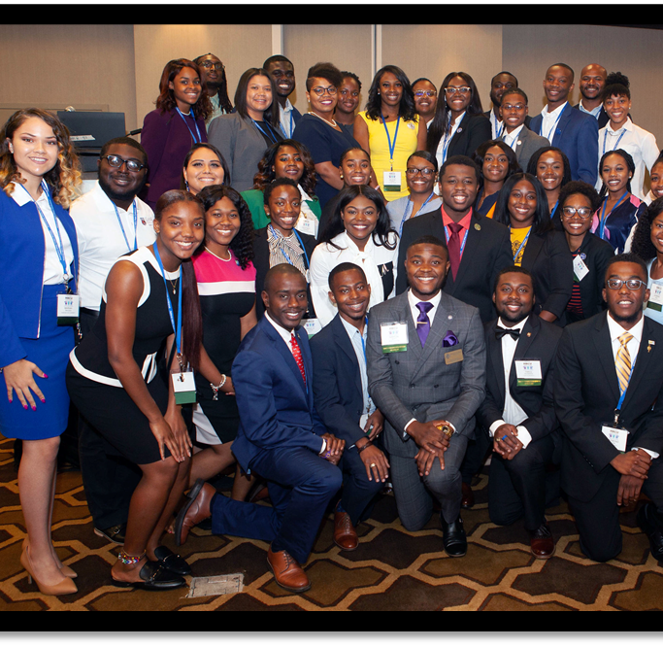
Student Engagement
HBCU Scholar Recognition Program
Monthly Webinars & Scholar Master Classes
Campus Events and Career Fairs
Outreach
Notes:
Student outreach and Engagement is conducted by the office in various ways.
Today we are going to cover Initiative Student Programs, along with Interagency Student Program and explain how you, as our partner can get involved.

Slide 10
President's Board of Advisors on HBCUs
Advising the President, through the Initiative, on all matters pertaining to strengthening the educational capacity of HBCUs.
Meetings
February 14, 2020- Washington, DC
September 23, 2020- Washington, DC
Notes:
As mentioned in the intro, the executive order established the Initiative as well as a President’s Board of Advisors on HBCUs.
The Board plays a vital role in advising the President of the United States on all matters pertaining to strengthening the educational capacity of HBCUs.
Pictured here are the Chairman Johnny C. Taylor, Jr. president of the Society for Human Resource Management as well as 13 members comprised of representatives from the philanthropic, education, business, finance, entrepreneurship, private foundations and sitting HBCU presidents.
The Board meets biannually and submit a report on the status their efforts to improve the competitiveness of HBCUs.
Agendas are set in collaboration with the Chair and if warranted our office may be in contact to request additional information about your agency’s priorities and strategic goals.
Meetings are open to the general public and offered in a virtual format as well. There’s a link to the previous meeting in this slide deck. Future meeting notices will be published in the Federal Register as required by law.

Slide 11
HBCU Week Annual Conference
Lead: Sedika.Franklin@ed.gov

Slide 12
Initiative Point of Contacts
Dr. Arthur McMahan; Senior Associate Director, Arthur.Mcmahan@ed.gov
Sedika Franklin; Associate Director, Sedika.Franklin@ed.gov
Tammi Fergusson, Intergovernmental Affairs Coordinator, Tammi.Fergusson@ed.gov
Elyse Jones; Outreach and Engagement Coordinator, Elyse.Jones@ed.gov
Cameron Lewis, Pathways Fellow, Cameron.Lewis@ed.gov
HBCU Newsletter, HBCUNewsletter@ed.gov
Notes:
On this slide you will find the contacts for the White House Initiative on HBCUs.
Any inquiries regarding Clusters, White House or Secretary level matters, please reach out to Dr. Arthur McMahan.
Inquiries towards private industry or the National HBCU Week Conference, please reach out to Sedika Franklin.
Inquiries or concerns regarding Federal Agencies, please direct your correspondence to Tammi Fergusson.
All inquiries or requests for student engagement, please direct your emails to Elyse Jones.
All submissions for the weekly HBCU Newsletter, please submit copy ready announcements to HBCUNewsletter@ed.gov
All other general concerns, can be addressed to Cameron Lewis or the WHIHBCU General Mailbox.

