Slide 2
Eligibility
Maximum Awards
U.S. citizen
Planning to study a foreign language in an eligible world region
Matriculated at an accredited U.S. institution or applying to a graduate school
Non-citizen of destination country
BOREN SCHOLARSHIPS
$25,000 / 25-52 weeks*
$12,500 / 12-24 weeks
$8,000 / 8-11 weeks (STEM)
BOREN FELLOWSHIPS
$25,000 / 25-52 weeks*
$12,500 / 12-24 weeks
+ Up to $12,000 for domestic
/eligible-programs
* Preferred duration of study;
All durations preferred for undergrad STEM applicants to Boren Scholarships
Notes:
On Eligibility:
Students that plan to graduate before the period of their award will start should contact their campus representative (see menu bar on www.borenawards.org) to see what they would need to do to remain enrolled/matriculated while overseas. Many universities have been able to make accommodation. Refer questions about rules on matriculation, credit requirements, etc. to campus representatives.
Winners of the Boren Scholarships or other study abroad awards (e.g. Fulbright, CLS, Gilman) are still eligible to win the Boren Fellowships while pursuing a graduate degree.
On Maximum Awards:
For Boren Scholarships, we define a year as anything over six months of in-program time. Undergraduate STEM (Science, Technology, Engineering, Mathematics) students may apply for summer-only programs abroad. All undergraduates should begin researching programs by speaking to their campus representatives and reviewing their home institution’s study abroad options to see if they meet our program preferences and the applicant’s language learning goals.
For Boren Fellowships, the total maximum award for domestic + overseas is $30,000. The (optional) domestic component must occur immediately prior to going abroad. Boren Fellows are encouraged to construct their own program plan based on their academic interests and career goals. These programs must include a substantial language learning component, but may also include academic coursework, internships, and/or graduate-level research.

Slide 3
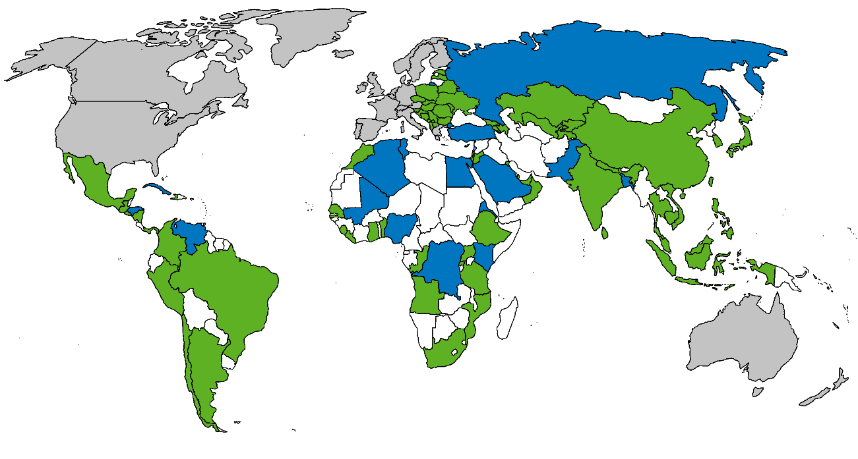
Self-Identified Program Preferences
Duration Abroad
Country
Language
Field of Study
/eligible-programs
*Applicants to blue-colored countries must specify a viable alternate plan in another appropriate country for the same language of study
Notes:
If an applicant elects to go outside one of these preferences, they will need to explain why in their application. Like all applicants, they will need to make a strong case according to the selection criteria of national security, public service, and language study.
Duration Abroad: We have a strong preference for longer-term overseas programs. Over 95% of Boren Fellows and over 85% of Boren Scholars study abroad for a full academic year. Undergrad STEM majors have the option of applying for summer-only programs.
Country: We have polled U.S. federal government agencies on the countries for which they need more regional expertise; the shaded countries are their preferences. Preferred countries shaded blue are ones that we may not be able to send people to next year. People who apply to those as their first choice must state a backup plan in case those countries are not approved.
Language: A full list of preferred languages can be found on our website. Our most popular languages are Arabic, Mandarin, Portuguese, Russian, Korean, and Swahili. Note that the only preferred languages for Latin America are Haitian Creole and Portuguese. All indigenous languages of preferred African countries are considered preferred languages. French is only a preferred language under the African Flagship Languages Initiative (AFLI), which also includes Portuguese, Akan/Twi, Swahili, Wolof, and Zulu. Applicants interested in Hindi and Urdu should consider the South Asian Flagship Languages Initiative (SAFLI). More information on AFLI and SAFLI is available on our website, www.borenawards.org.
Field of Study: This preference is not as important as the first three, but the few applicants whose fields of study are outside of our preferences will need to address how service with the federal government fits in with their academic interests or career goals. Our preferred fields are Business, Language & Area Studies, Law/Public Policy/Public Administration, Social Sciences, and STEM (Science, Technology, Engineering & Mathematics).

Slide 4
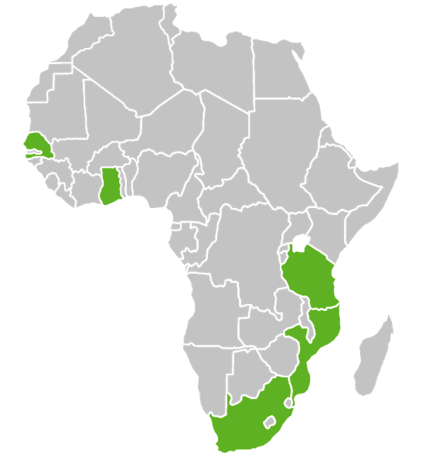
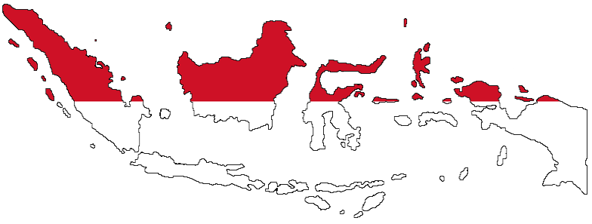
Regional Language Initiatives
Great for beginners or undecided applicants!
Domestic Summer, Overseas Fall & Overseas Spring (Opt.)
Programs in:
AFLI: French (Int./Adv.), Swahili, Akan/Twi, Wolof & Zulu
SAFLI: Hindi & Urdu
IFLI: Indonesian
TURFLI: Turkish
/initiatives
Notes:
In addition to the majority of programs which are identified or designed by the applicant, the Boren Awards offers three regional language initiatives to encourage more students to study particular languages and countries. These programs have domestic summer and overseas fall components, as well as the option to extend into the spring. All programs receive academic credit from U.S. university (either the University of Florida, the University of Wisconsin, or Bryn Mawr College, depending on the program). These programs are appropriate for students at all proficiency levels including beginners, with the exception of French, which requires intermediate proficiency.
The African Flagship Languages Initiative (AFLI) is for the study of French, Swahili, Akan (or Twi), Wolof, or Zulu.
The South Asian Flagship Languages Initiative (SAFLI) is for the study of Hindi or Urdu.
The Indonesian Flagship Language Initiative (IFLI) sends students to Indonesia to study its principal official language.

Slide 5
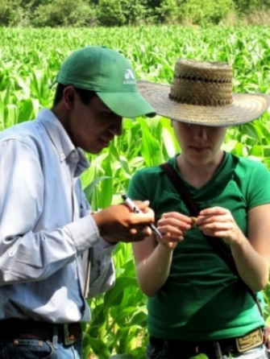
What Makes a Strong Applicant?
Interest in public policy dimensions of field of study
Desire to pursue a career with the federal government
Serious commitment to language study
/essays
Notes:
All of these questions are addressed in the two essays on the application.
National Security Argument: We recognize a broad definition of national security, that can encompass diplomacy/defense/development as well as other transnational issues of concern to the U.S. government, such as global public health, food security, the rights of women and children, environmental protection, trade, etc. While we recognize a broad definition, you (the applicant) must make an argument specific to your academic interests and professional goals.
Public Service Plan: Boren Scholars and Fellows commit to at least one year of service with the federal government in an internationally focused position. Preference is given to applicants who demonstrate a longer-term commitment to work in the federal government.
Language Study Plan: Applicants should demonstrate a serious interest in language study before, during, and after the period of their Boren-funded program. Strong applicants set realistic expectations for proficiency gains based on their existing level, and select overseas programs to achieve those goals. Nearly all of the languages we fund have no maximum or minimum proficiency requirement, so student should design/select programs that make sense at their initial proficiency level.

Slide 6
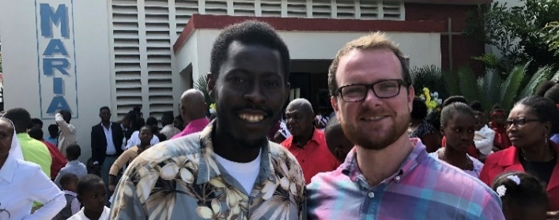
Application Requirements
Essays
Letters of Recommendation
Transcript(s)
Letter of Overseas Affiliation or Study Abroad Program
Successful candidates have:
Met most preferences
Clearly addressed national security
Specific & realistic career goals
Created a study plan that is challenging, relevant & feasible
Demonstrated their commitment to language study
Made sure they clearly answer all elements of the essay questions
/essays
Notes:
Scholarship Online Application:
2 Essays
2 Recommendations (+1 optional)
Budget
Transcript(s)
Language Self-Assessment
Language Proficiency Form (optional)
Study Abroad Program Description
Fellowship Online Application:
2 Essays
3 Recommendations
Budget
Transcripts
Language Self-Assessment
Language Proficiency Form (optional)
Letter of Overseas Affiliation (not required at time of application)

Slide 7
Application deadlines
National deadlines are for study that will begin after June 1, 2021 or before March 1, 2022
BOREN SCHOLARSHIPS
February 3, 2021
BOREN FELLOWSHIPS
January 27, 2021
/apply-now
Notes:
The Boren Awards have one application cycle per year. Applications for each award are due on the dates listed here at 5 pm EST. Boren Awards-funded study may begin as early as June 1 of the application year, or as late as March 1 of the following year. Once the program has started, the planned study should be continuous (allowing for short, infrequent, and pre-approved breaks).

Slide 8
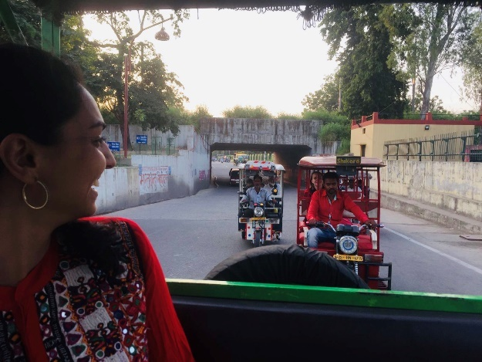
Notes:
The email address, boren@iie.org, is the best way to get a quick and thorough response. Questions not addressed in these slides or the notes that accompany them should be referred to boren@iie.org.
You (Boren Ambassadors) can contact me any time at jcary@iie.org or 202-487-7011.

