Slide 1
Emerging Trends in Talent Acquisition
Michelle S. LoweSolis
Director, Defense Civilian Personnel Advisory Service (DCPAS)

Slide 2
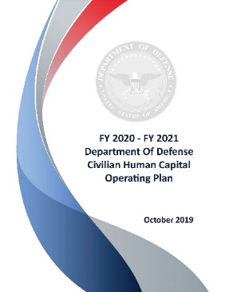
Our Goal
FY 2020- FY 2021 DoD Human Capital Strategy
1.1 Improve Recruitment and Hiring
1.1.1 Increase awareness of the Department’s civilian employment opportunities to attract candidates
03

Slide 3
Our Jobs
DoD Civilian Workforce
~900K positions around the globe
Contracting / Acquisition – 28K
Cyber – 58K
Education – 32K
Engineering – 88K
Facilities Engineering – 63K
Financial Management – 45K
Human Resources – 24K
Law Enforcement & Safety – 34K
Logistics & Supply – 180K
Medical – 45K
Science & Technology – 13K
03

Slide 4
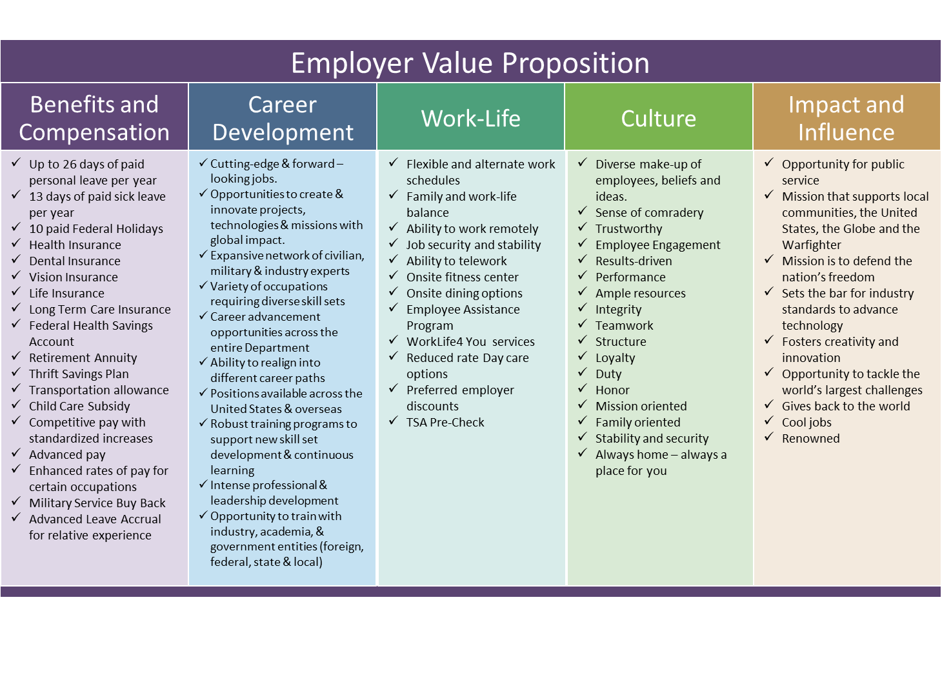
Our Value Proposition

Slide 5
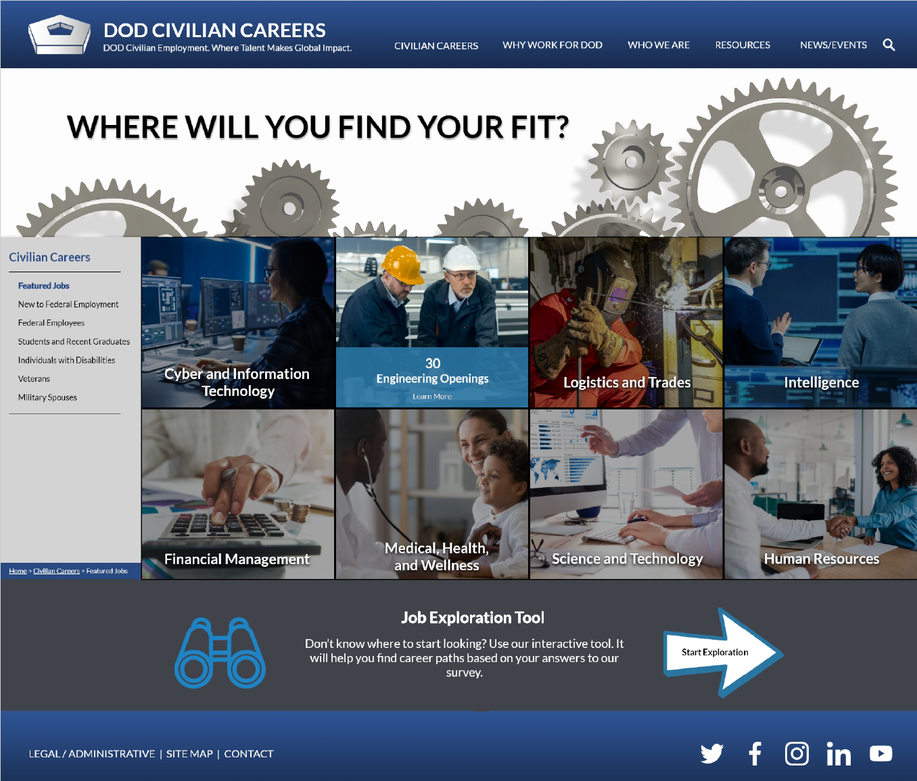
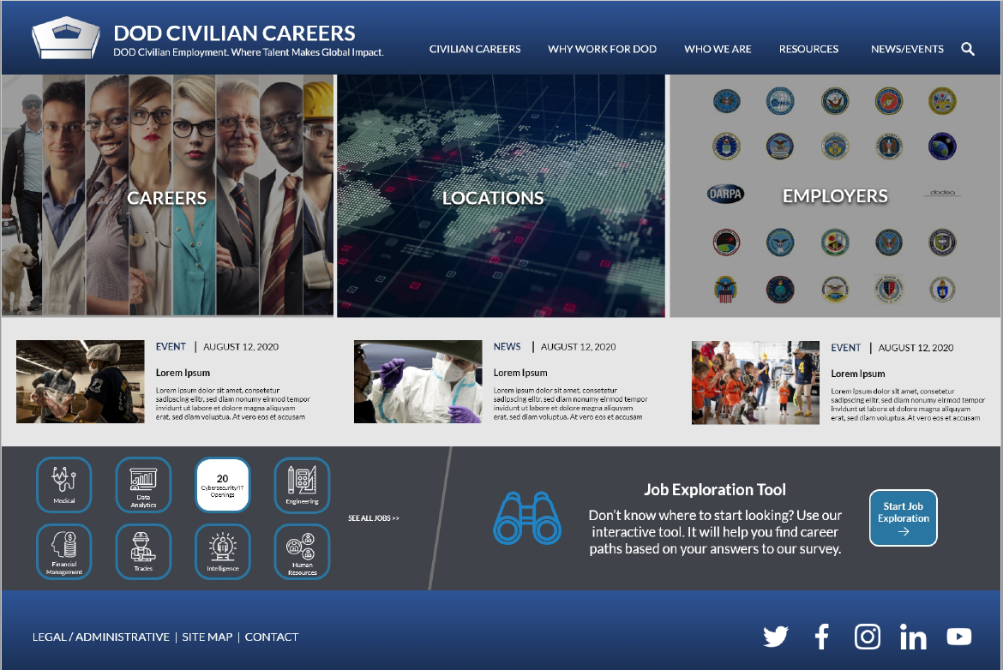
DOD Civilian Careers

Slide 6
Resources
DoD has student internship programs
Air Force Premier College Intern Program (https://afciviliancareers.com/student-roa/)
Naval Research Laboratory HBCU/MI/TCU Research Internship Program (https://www.nrl.navy.mil/hbcu/welcome)
Department of Navy's HBCU/MIs program (https://www.onr.navy.mil/Education-Outreach/HBCU-MI-Historically-Black-Colleges)
Army Educational Outreach Program (https://www.usaeop.com/)

Slide 7
Hiring Authorities
DoD Direct Hire Authority for Post-Secondary Students and Recent Graduates
Allows the DoD to appoint qualified post-secondary students and recent graduates directly into professional and administrative occupations
A post-secondary student is a person who is currently enrolled in a baccalaureate or graduate degree full-time program and has completed at least one academic year
A recent graduate is a person who was awarded a degree by an institution within the last two years.
Office of Personnel Management Pathways Program, https://www.usajobs.gov/Help/working-in-government/unique-hiring-paths/students/
Available for use by most Federal agencies; not specific to the DoD
Pathways Program opportunities are available through USAJOBS

Slide 8
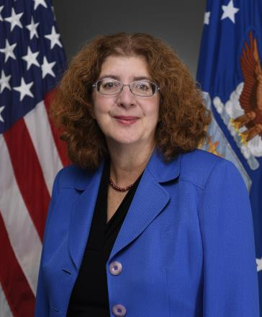
Ms. Michelle LoweSolis is the Director, Defense Civilian Personnel Advisory Service. She is responsible for the development and oversight of civilian human resource plans, policies, and programs for more than 950,000 Department of Defense employees worldwide. Ms. LoweSolis’s portfolio spans the full spectrum of Human Capital Management, to include workforce planning, talent acquisition and management, development and sustainment, performance management, labor and employee relations, and leader development.
For more Information:
Email: dodhra.mc-alex.dcpas.mbx.soar@mail.mil

